Slide 1
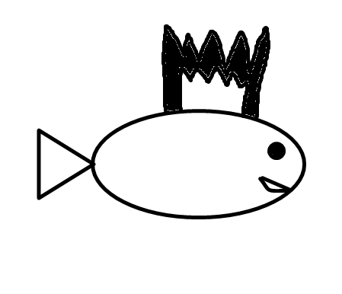
Chatboard
EECS 393
Justin Michel
Jeff Willebrand
Felix Yuan

Slide 2
Background
Many Multiprotocol IM’s
Similar to Digsby
Adium for mac
Many whiteboards
Microsoft live meeting
Popular as a live action tool
Especially as students in computer science/engineering

Slide 3
Conception
Take the above to concepts and put them together
Concinella already does this
What are the unique features of Chatboard then?
Java based
Metaphors

Slide 4
Metaphors
IM as chatting: IM clients chatting to each other in the same protocol are like two people of the same language talking to each other through an interpreter
So extend this to multiprotocol: We want our client to be able to know more languages
Whiteboard as a door greeter
A whiteboard while one is offline is capable of being drawn on by a roommate or a friend
Whiteboard as a collaboration tool
The most generally used version of the whiteboard

Slide 5
Parts
External libraries (model):
Many of the ideals of multi-protocol chatting have been set for us in XMPP the Smack API
Also looking at the Openfire server
GUI (view):
Windows
Preferences windows
Core (controller):
IM
Network
Utility
Whiteboard

Slide 6
Core IM and network
Felix

Slide 7
Main principle
Encapsulate the models further
Have Justin and Jeff do as little work as necessary with the raw objects
Handle exceptions
Code to be able to handle connections to servers

Slide 8
Using the Smack API’s
The XMPP protocol is embedded within models that are ready to use with Smack
Allows communication with any Jabber protocol
Includes: Jabber, Gtalk, etc.
Core IM extends many of these classes

Slide 9
Functions
Handles connections and exceptions
Handles passwords and other sensitive data
Handles incoming messages and outgoing ones in queue based way
Handles synchronous roster changes opaquely, preventing views from the GUI

Slide 10
Core whiteboard
Jeff Willebrand

Slide 11
Computing problems
Drawing
This is a solved problem
Many packages allow for drawing
More interesting
How do you sync the two images

Slide 12
Network Synchronization
Two possibilities
Send commands via queue
Slow
May take up a lot of network bandwith
Synchronize the two images
Faster
Computationally hard problem

Slide 13
GUI
Justin Michel

Slide 14
GUI – Swing
Using Swing, as it is the best supported GUI architecture for Java
Not AWT because Swing will keep our look and feel consistent across all Operating Systems.
Also, can easily modify the look and feel by plugging in a different L&F from the internet.

Slide 15
Reusability
One common occurrence in a GUI is that many windows will use similar functions and features, such as an OK or Cancel button
Can handle this common code by making an abstract base window class that implements these common features
How to use this abstract class in a smart way?

Slide 16
Factories
Can use a factory to create all the subclasses of the abstract base class in an automated fashion.
Doing this allows easy reuse of code.
It also encapsulates the code nicely.
An enumeration also allows for easy hookups of menu code.

Slide 17
Infrastructure
Wrapping up

Slide 18
Infrastructure
Github for version control
Eclipse for development
UNIX server for hosting our openfire
Ticketing and Bug fixes tbd
No development blog/twitter/wiki at the moment
Project for Fall break

Slide 19
Blocks and problems
Whiteboard as expected biggest issue
Originally, multiprotocol IM was to be an add on
Evolved into IM being most important section, Whiteboard as subsection
Installing Openfire
Learning Factory in Java

Slide 20
Next steps
Finalize multiprotocol IM’s
Demo of whiteboard
Whiteboard integration
Finish gui
Figure out how to pass whiteboard about

Slide 21
QUESTIONS

